Slide 1

LinkedIn Sponsored Messaging Ad Formats
Message & Conversation Ads
Marketing Operations
Business Partnership and Orchestration

Slide 2
Agenda
Welcome
Introduction to LinkedIn Ad Formats
How Sponsored Messaging ads work
Features of Message and Conversation Ads
Best Practices for Message and Conversation ads
Open Q&A/Discussion

Slide 3

Marketing Operations Open Office Hours
Get your questions answered by the marketing operations team. Open Office Hours are held monthly with the following agenda:
  Learn about a tip or best practice
  Ask a question – Pre-submit your questions here or ask during the office hours
  Learn how to leverage IQVIA’s marketing systems and processes most effectively
Action: Sign up here, if you need to be added to the outlook invite
Reminder: Save your questions for the end or enter in the chat. We will address as many as we can!

Slide 4
Introduction to LinkedIn Ad Formats and Specifications
Welcome to the definitive guide on LinkedIn Ad Formats and their specifications. In this presentation, we will navigate through the Message and Conversation ads and cover their design recommendations and best practices.
Sponsored Content
Single Image ad
Document ad
Video ad
Carousel ad
Sponsored Messaging
Conversation Ads
Message Ads

Slide 5
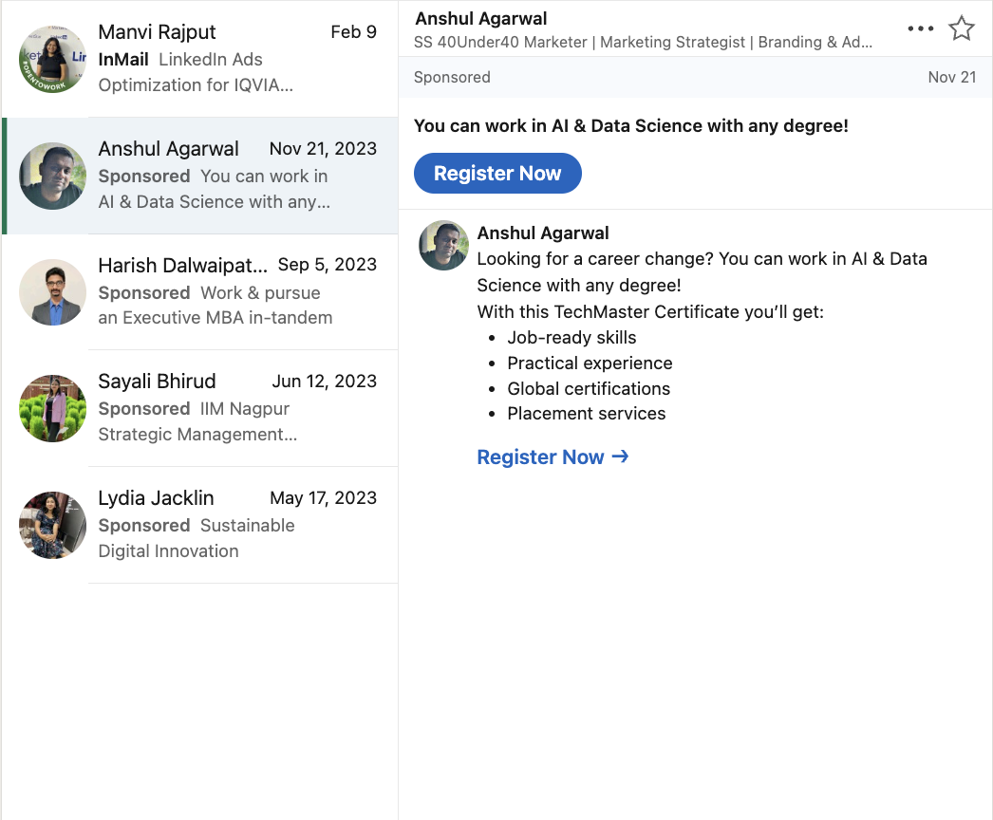
How Sponsored Messaging ads work
Delivered in real-time, when Target Audience are active on LinkedIn.
Message and Conversation ads are delivered to your Target Audience on both mobile and desktop.
To prevent fatigue, LinkedIn members only receive the same message ad once every 45 days.

Slide 6
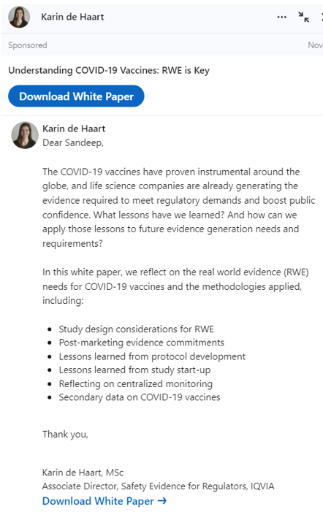
What Are Message Ads?
Message ads deliver direct messages to your prospects through LinkedIn Messaging, encouraging action. These ads are native, meaning they’re designed to blend seamlessly with regular LinkedIn messages. They can appear on both desktop and mobile devices.
Here are some features of LinkedIn Conversation Ads:
Deliver a targeted message with a single CTA. However, we can add multiple hyperlinks within the content.
Drive stronger engagement and response than traditional emails
For design details we suggest you visit LinkedIn conversation ad design recommendations.

Slide 7
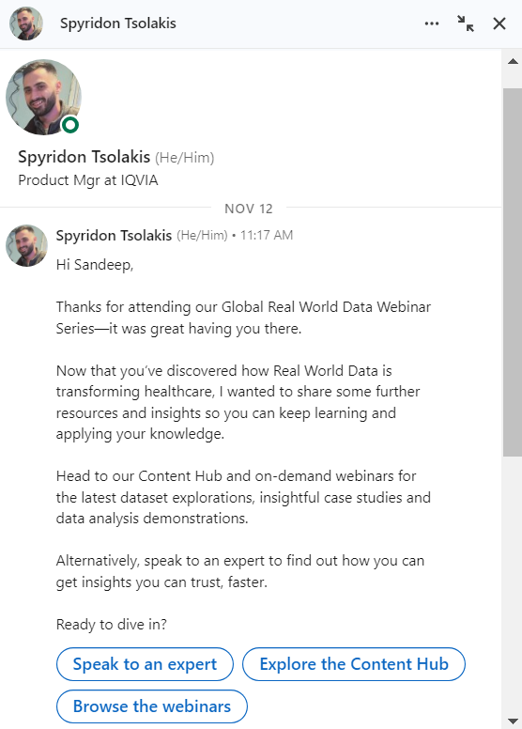
What Are Conversation Ads?
LinkedIn Conversation Ads are a form of native advertising that enables advertisers to engage in two-way conversations with their target audience. They offer a more interactive and personalized advertising experience compared to other formats.
Here are some features of LinkedIn Conversation Ads:
Multiple call-to-action buttons: Advertisers can set up multiple call-to-action buttons that can link to landing pages, open a Lead Gen Form, or encourage engagement with more information in the next message.
Personalized: Advertisers can target their audience based on specific criteria.
For design details we suggest you visit LinkedIn conversation ad design recommendations.

Slide 8
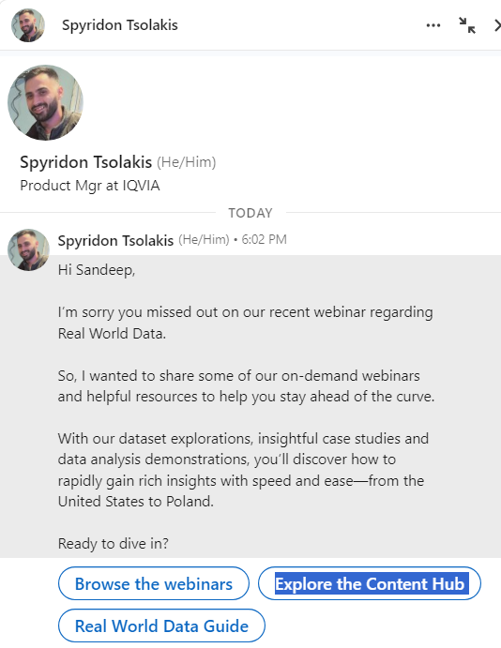
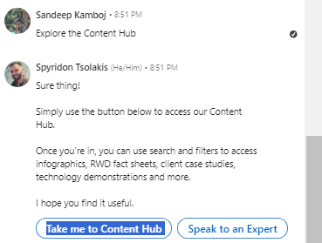
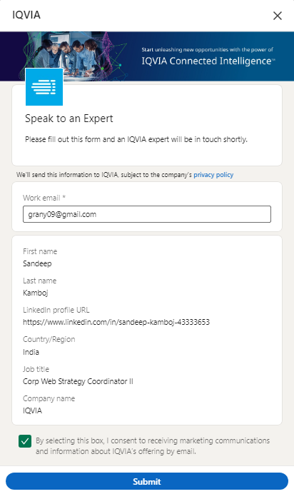
Conversation Ad Flow
Take me to Content Hub
Take me to Content Hub takes you to the website link

Slide 9



Best Practices for Sponsored Messaging ads
Sponsored Messaging
Sender's profile
Credible sender
Sponsored Messaging ads see the highest open rates on Tuesdays and get the most clicks on weekends.
A/B Test – Use multiple messages / Subject lines / Offer CTAs.
Don't include "not interested" CTAs. Uninterested recipients will simply close the ad. Instead, focus on CTAs that help achieve your business objectives.
Make sure the sender's profile image is a high-quality, professional image of their face.
Ask the sender to confirm in member settings that their profile photo should visible to LinkedIn members. It will need to be set to either "All LinkedIn Members" or "Public" for all recipients to see it.
Choose someone ideally with a title of director or higher; who is relevant to your message and credible to your audience. Set up your sender using LinkedIn’s permission process.

Slide 10
Thank You

